Slide 1
Class 12: Making Tidy Data Monday, February 11
INFO 3402: Information Expositions Professor Brian Keegan brian.keegan@colorado.edu

Slide 2
Agenda
11:00 – 11:05 → Review
11:05 – 11:20 → Tidying up messy data
11:20 – 11:50 → Notebook on tidying up messy data

Slide 3
Recap
Weeks 1 & 2 → Module 1: Exploring
Epicycles of analysis: question, EDA, modeling, interpretation, communication
Characteristics of a good question, Exploratory data analysis checklist
Weeks 3 & 4 → Module 2: Retrieving
Using requests, BeautifulSoup, etc. to scrape data from websites and APIs
Ethical considerations for web scraping
Weeks 5 & 6 → Module 3: Cleaning
Creating tidy data (pivoting, melting, stacking)
Handling missing data (dropping, filling, interpolation)

Slide 4
This week
Week 5 (Feb 11 – Feb 15) → Cleaning (Show)
Monday: Creating tidy data
Wednesday: Stacking, pivoting, and melting tutorial
Friday: Weekly presentation on assignment work-in-progress
Module Assignment 03 due February 25
Week 6 (Feb 18 – Feb 22) → Cleaning (Tell)
Handling missing data: dropping, filling, interpolating

Slide 5
Module Assignment 03
Due Monday, February 25 at 10:59am
Objective: Tell a horror story about an untidy dataset and how you tamed it into a “tidy”-er format

Slide 6
Tidy data
patient | treatment_a | treatment_b
John Smith | n/a | 2
Jane Doe | 16 | 11
Mary Johnson | 3 | 1
Each variable forms a column
Each observation forms a row
Each observational unit forms a table
“Messy”
patient | treatment | result
John Smith | a | n/a
Jane Doe | a | 16
Mary Johnson | a | 3
John Smith | b | 2
Jane Doe | b | 11
Mary Johnson | b | 1
“Clean”
Wickham (2014). “Tidy Data.” Journal of Statistical Software.

Slide 7
Common problems with data
Column headers are values, not variable names
Multiple variables stored in one column
Variables are stored in both rows and columns
Multiple observational units stored in the same table
A single observational unit is stored in multiple tables

Slide 8
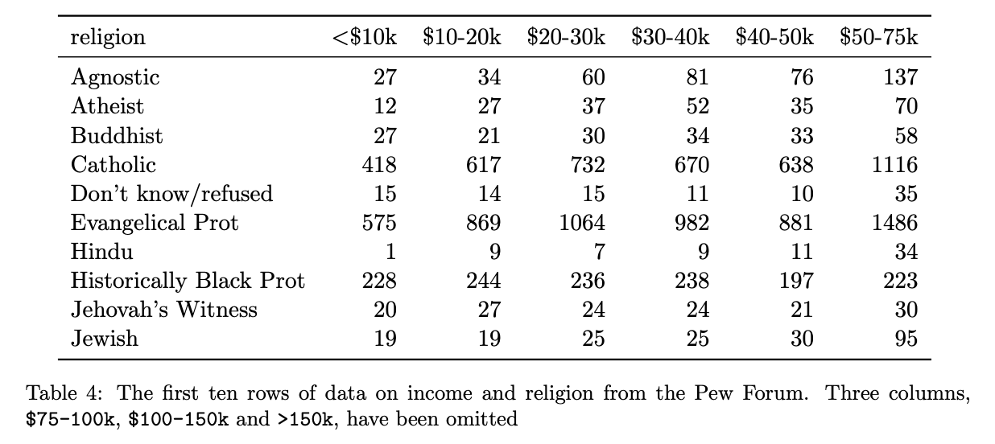
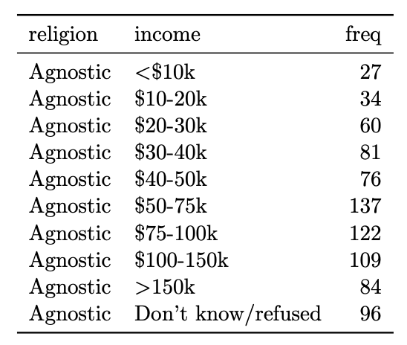
#1: Column headers are values, not variable names
3 variables before:
Religion (rows), Income (columns), Frequency (cells)
Melt → operation to convert columns into rows
3 variables after, 1 per column:
Religion, Income, Frequency

Slide 9
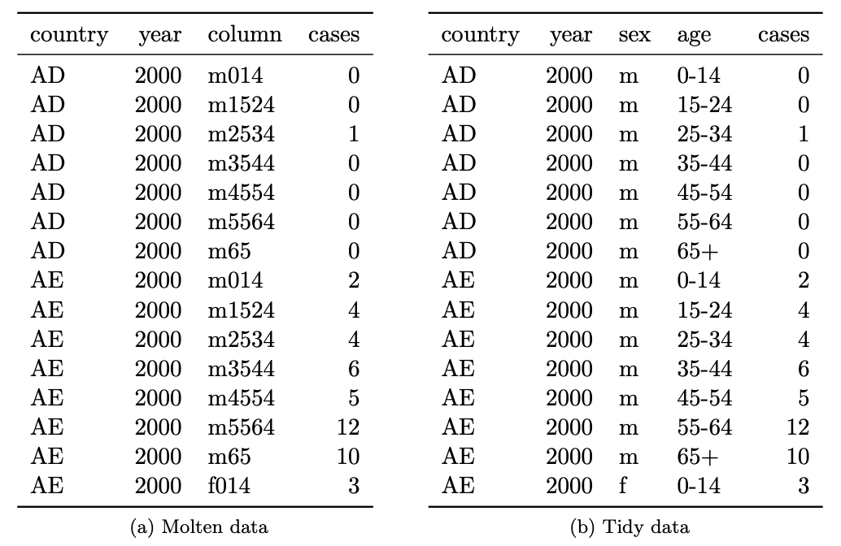
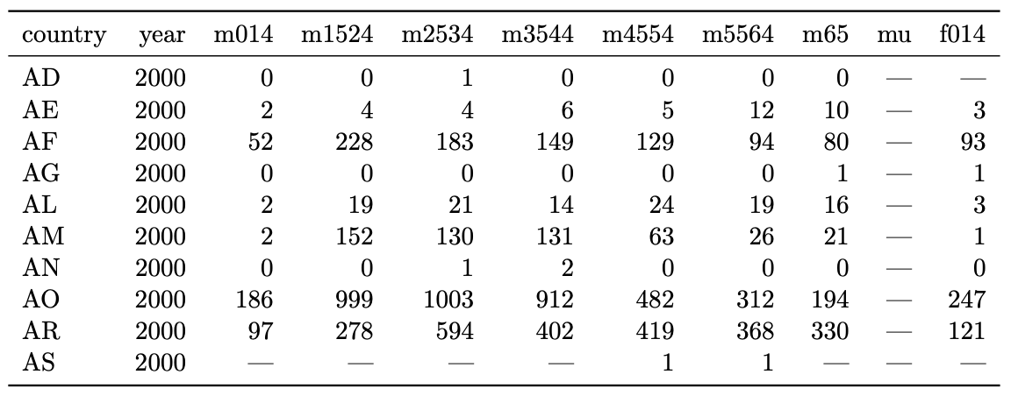
#2: Multiple variables stored in one column

Slide 10
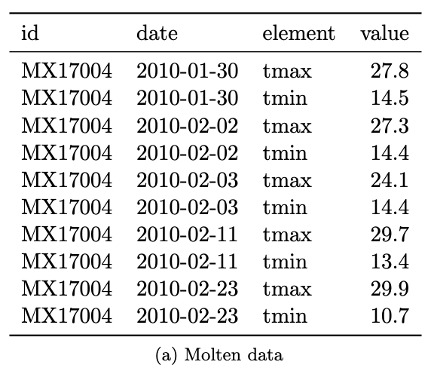
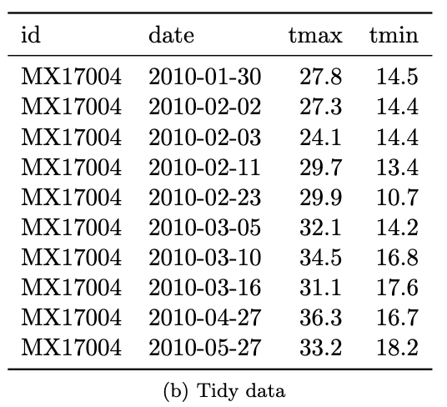
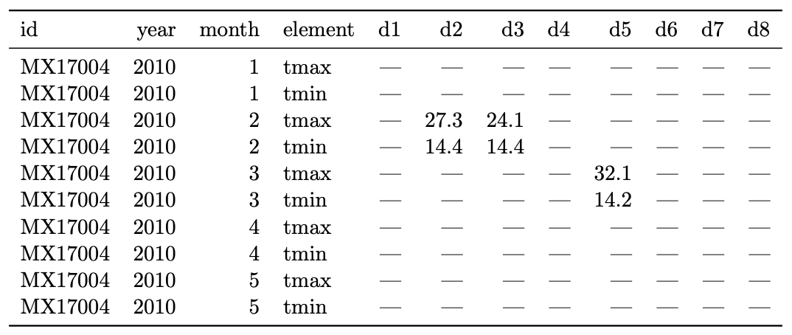
#3: Variables stored in both rows and columns

Slide 11
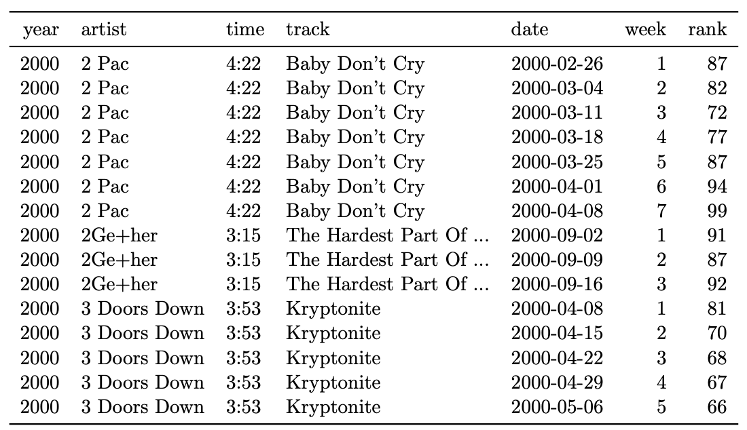
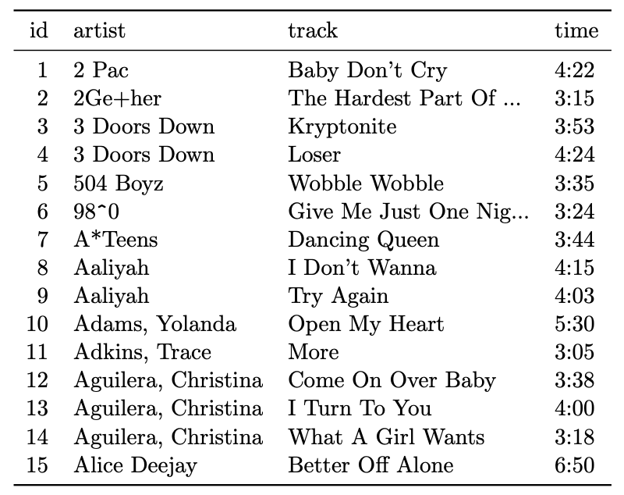
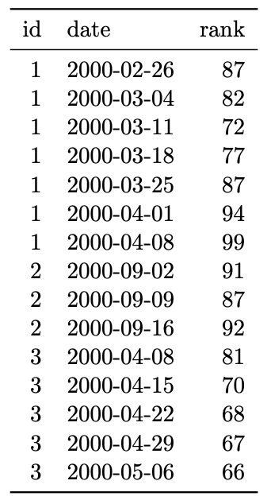
#4: Multiples types in one table

Slide 12
#5: One type in multiple tables
https://github.com/hadley/data-baby-names
https://github.com/hadley/data-fuel-economy

Slide 13
pandas data reshaping: unstack
http://pandas.pydata.org/pandas-docs/stable/user_guide/reshaping.html

Slide 14
pandas data reshaping: pivot
http://pandas.pydata.org/pandas-docs/stable/user_guide/reshaping.html

Slide 15
pandas data reshaping: stack
http://pandas.pydata.org/pandas-docs/stable/user_guide/reshaping.html

Slide 16
pandas data reshaping: unstack
http://pandas.pydata.org/pandas-docs/stable/user_guide/reshaping.html

